Slide 1









IMAGINE
OUR CONNECTED
by solar surfers

Slide 2

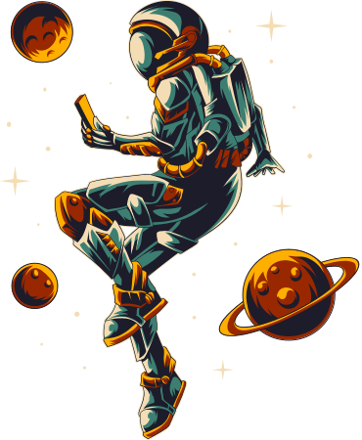

MEMBERS
01
04
HARMAN WAHEED
WARDA ALI
02
05
ALI ABBAS SHAH
BILAL ASIF
03
06
MOOSA SHAHID RAJA
SHAHNZAY
SHAHMEER

Slide 3



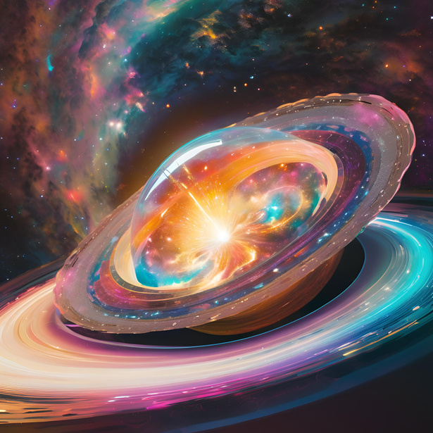
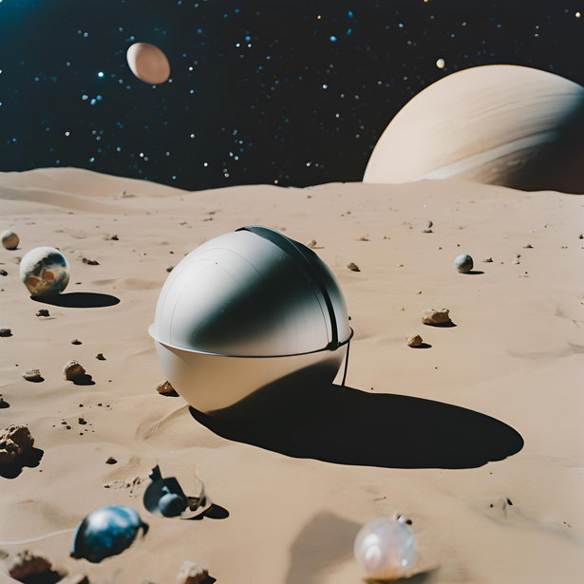
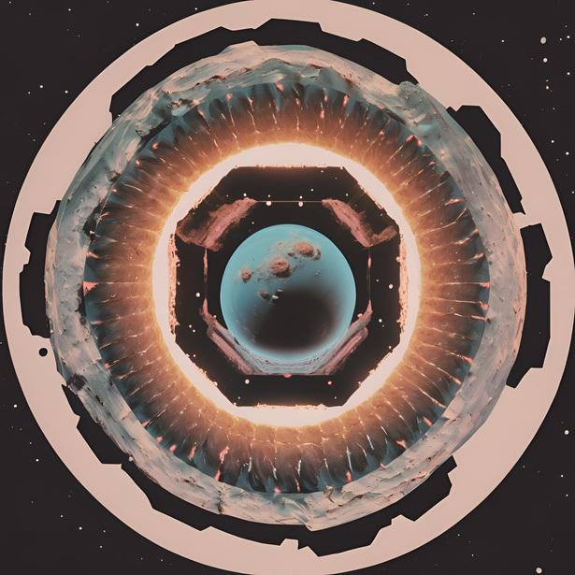

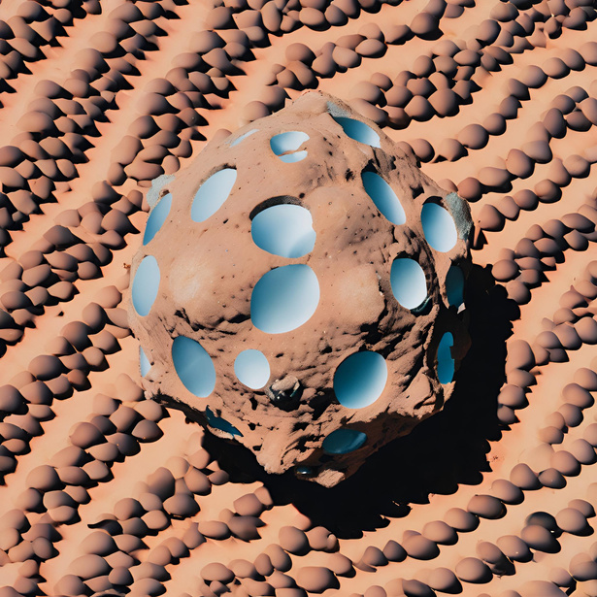
PROBLEM STATEMENT
Determining whether an asteroid poses a threat to Earth by analyzing its size, velocity, and is crucial for planetary safety.

Slide 4

OUR
METHODOLOGY
RANDOM FOREST
LOGISTIC REGRESSION

Slide 5
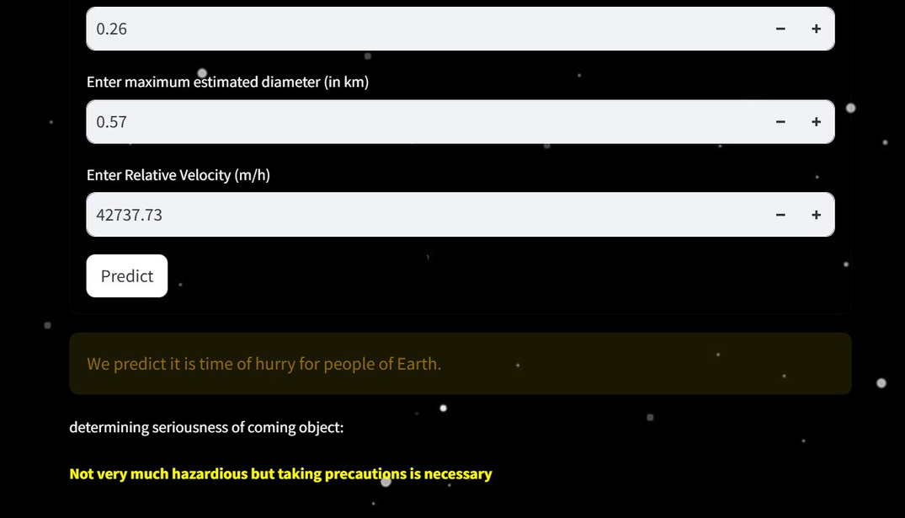
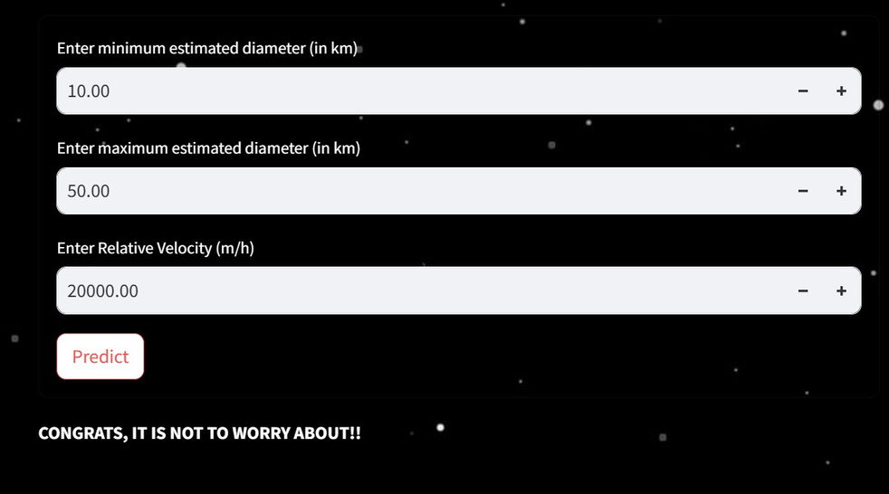

Slide 6
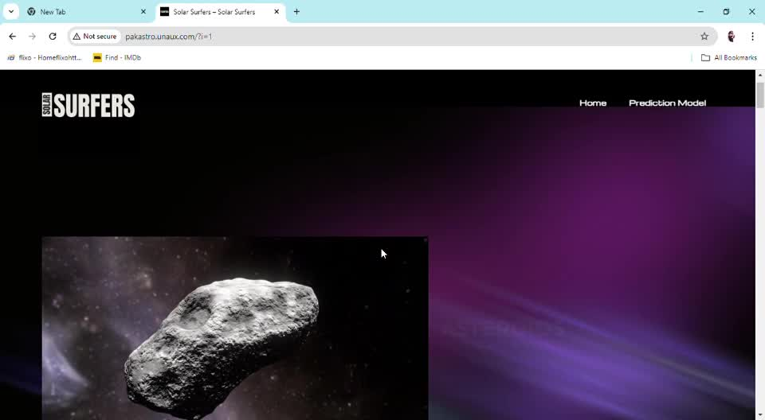
LINK
OUR WEBSITE

Slide 7
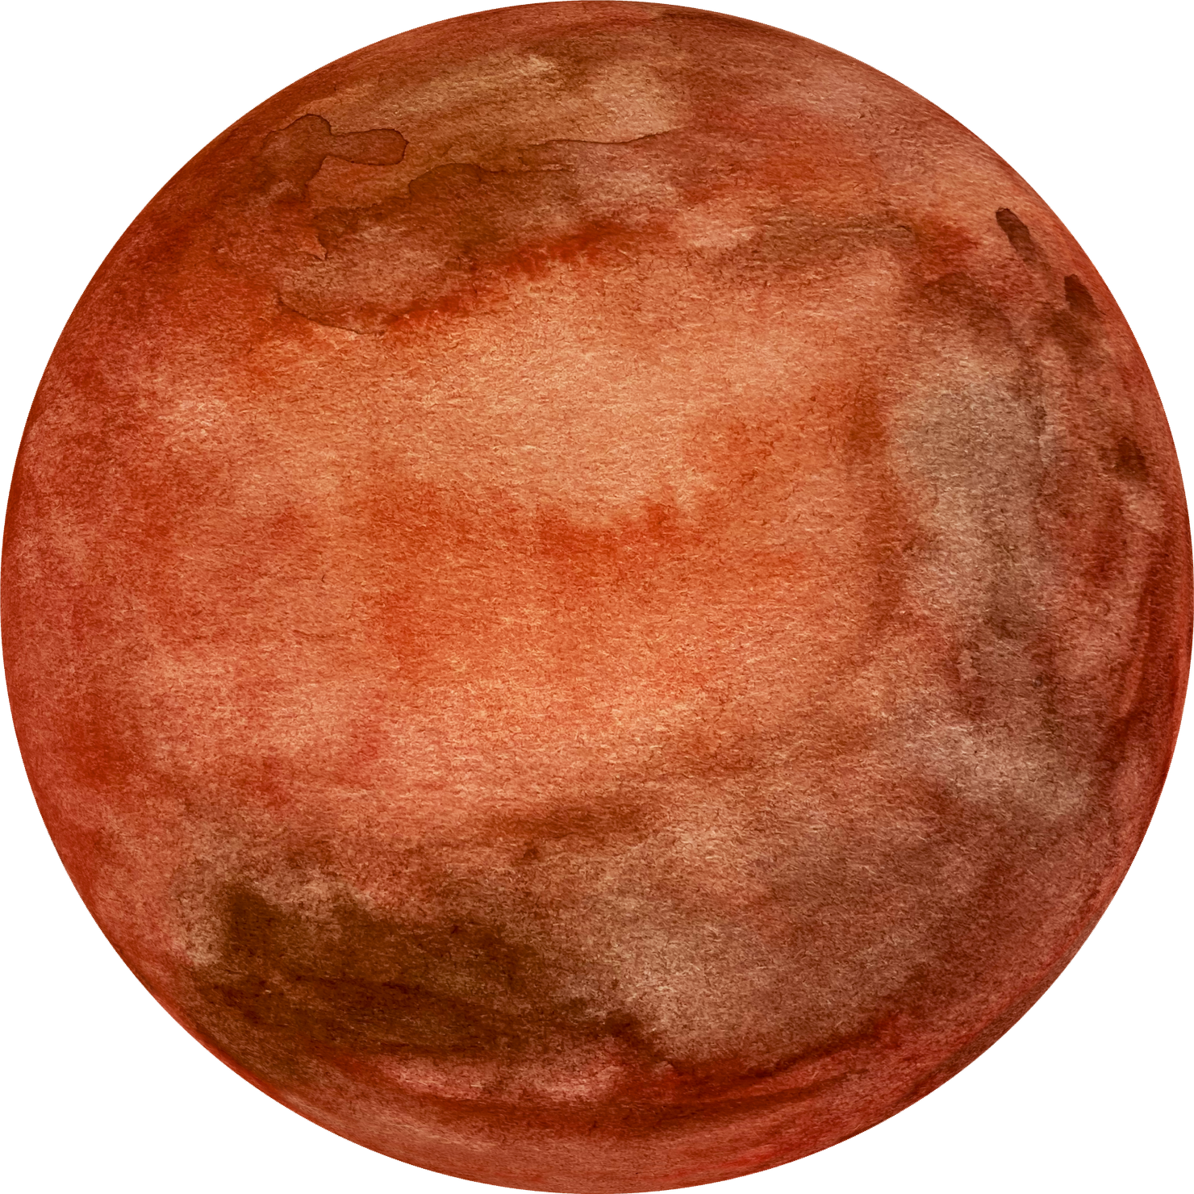

REFRENCES
Random Forest_link
Logistic Regression_link

